Slide 1

IST722 Data Warehousing
Dimensional Modeling
Michael A. Fudge, Jr.
Notes:
Power point slide have quizzes in them since this presentation is not interactive I’ve left those out. I encourage you to download the corresponding powerpoint and quiz yourself

Slide 2
Pop Quiz: T/F
The business meaning of a fact table row is known as a dimension.
A dimensional data model is optimized for maximum query performance / ease of use.
An attribute is a business performance measurement.
Order date & Shipping date use the same data. This is an example of a conformed dimension.
A degenerate dimension represents a dimensional key with no attributes.
Notes:
F Fact table grain.
T
F fact
T
T

Slide 3
Pop Quiz: T/F - Answers
The business meaning of a fact table row is known as a dimension. False (Fact table grain)
A dimensional data model is optimized for maximum query performance / ease of use. True
An attribute is a business performance measurement. False (Fact)
Order date & Shipping date use the same data. This is an example of a conformed dimension. True
A degenerate dimension represents a dimensional key with no attributes. True
Notes:
F Fact table grain.
T
F fact
T
T

Slide 4
Where are we?
Last Week:
We covered:
Requirements Analysis
We learned how to:
Turn Business Processes into Dimensional Models
High Level
This Week:
We’ll cover
Dimensional Modeling
We’ll learn how to
Design and implement dimensional models in relational databases.
Detailed

Slide 5
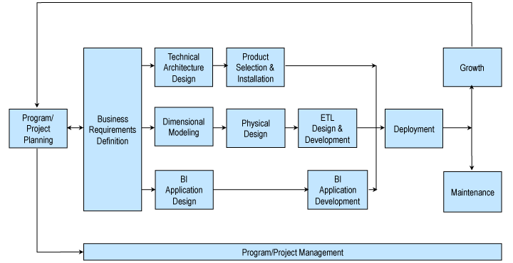
Recall: Kimball Lifecycle
Notes:
Describes an approach for data warehouse projects

Slide 6
Kimball: From Business Process To Dimensional Models
Fact
Project
Business
Processes
Fact
Program
Project
Business
Processes
Fact
Project
Fact
iSchool DW Program
Remote Lab
Remote Lab Sessions
Login Time in Minutes
Example:

Slide 7
Terminology Translator: Requirements Analysis vs. Design & Impl.
Requirements Analysis
Design & Implementation
Business Process
Fact
Dimension
Dim. Model
Business Processes “Uses” a dimension
Fact Table
Column in Fact Table
Dimension Table
Star Schema
Foreign Key

Slide 8
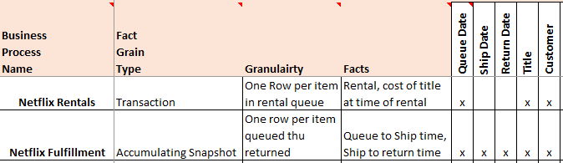
Enterprise Bus Matrix – A documentation tool
A key deliverable from requirements gathering, the bus matrix documents your business processes, facts and dimensions across all projects in your program.
Notes:
For example the sales forecasting business process requires the following dimensions.

Slide 9
Group Activity: Build A Bus Matrix
TODO:
Identify the business processes, facts and dimensions for your group’s business processes.
Your prof will create an enterprise bus matrix based on the entire program. Using the excel worksheet.
STEPS:
Identify Business Processes & Type
Transaction – Single Event
Periodic Snapshot – Point in Time
Accumulating Snapshot – Events over Time
Identify Facts of the business process
Should be Additive, or at least Semi-Additive
Identify the dimensions used by the business process

Slide 10
Dimensional Model Design
Now that you have dimensional models, its time to focus on how to build the relational structures to support it.

Slide 11
What is Dimensional Modeling
A Logical design technique for structuring data with the following objectives:
Intuitive: Easy for business users to understand
Fast: Excellent query performance
Think of a Dimensional Model as a fact table + the dimensions it requires.
Dimensional Models are implemented in the Relational DBMS as star schemas. The exist in MOLAP databases as cubes.
Notes:
Remember one of the key reasons the discipline of data warehousing exists, is that the STRUCTURE of data we have in our transactional systems is not very conducive to ad-hoc querying and analytics. The goal of dimensional modeling is to re-shape our data into a form more queryable by end-users.

Slide 12
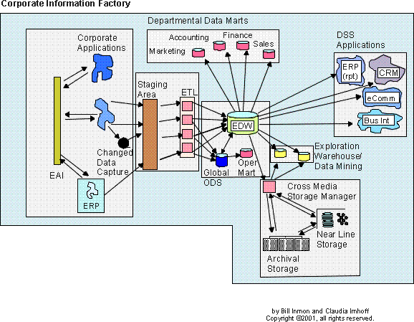
Where are the Dimensional Models in the CIF?
Red: NOdels Green: YES Models

Slide 13
Components of the Dimensional Model
Fact Table – A database table of quantifiable performance measurements (facts). Originate from business processes. Has FK’s to each of the dimensions.
Ex. Sales Amount, Days To Ship, Quantity on Hand.
Dimension Table – A table of contexts for the facts.
Ex. Date/Time, Location, Customer, Product
Attribute – A characteristic of a dimension.
Ex. Product: Name, Category, Department
Star Schema – Connections among facts and dimensions which define a business process.
Ex: Sales, Inventory Management

Slide 14
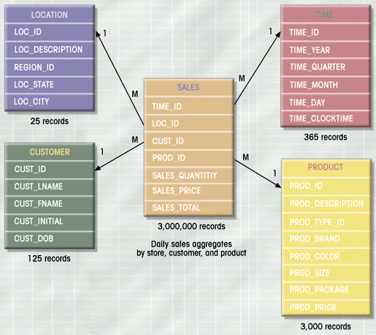
Star Schema: Relational answer to the DM
Dimension Table
Primary Key
The Star Schema
Is a Relational Database
Implementation
Of A
Dimensional
Model
Fact Table
Attribute
Foreign Key
Fact

Slide 15
Rules of Fact Table Design
The Primary Key of your fact table uses the minimum number columns possible & no surrogate keys. (It should be made up of FK’s and Degenerate Dimensions)
Referential Integrity is a must. Every foreign key in the fact table must have a value.
Avoid NULLs in the foreign key by using flags which are special values in place of null.
Ex. “No Shopper Card” in Customer Dimension
The granularity of your fact table should be at the lowest, most detailed atomic grain captured by the business process. (discussed last time)
Each fact should be Additive, or re-designed to be as additive as possible.
Each fact must be of the of the same granularity.

Slide 16
What's Wrong w/This Fact Table of Basketball Player game stats?
Stat ID (PK) | Player ID | Game ID | Shot Attempts | Shots Made | Points | Pts Per Shot | Shooting Pct
1 | Jordan | 1 | 3 | 2 | 5 | 1.667 | 0.667
2 | Jordan | 2 | 7 | 6 | 12 | 1.714 | 0.583
3 | Miller | 1 | 2 | 0 | 0 | 0.000 | 0.000
4 | Miller | 2 | 5 | 3 | 9 | 1.800 | 0.600
5 | Miller | 1 | 2 | 0 | 0 | 0.000 | 0.000
Can you find the 3 things wrong with the implementation of this fact table?
Notes:
No surrogate key
Not discretely values
Poor data quality
Incomplete / missing data
Poor descriptions
Non-verbose data

Slide 17
What's Wrong w/This Fact Table?
Non Additive Facts
Poor PK
Choice
Stat ID (PK) | Player ID | Game ID | Shot Attempts | Shots Made | Points | Pts Per Shot | Shooting Pct
1 | Jordan | 1 | 3 | 2 | 5 | 1.667 | 0.667
2 | Jordan | 2 | 7 | 6 | 12 | 1.714 | 0.583
3 | Miller | 1 | 2 | 0 | 0 | 0.000 | 0.000
4 | Miller | 2 | 5 | 3 | 9 | 1.800 | 0.600
5 | Miller | 1 | 2 | 0 | 0 | 0.000 | 0.000
Poor Choice of FK (or PK)
Can you find the 3 things wrong with the implementation of this fact table?
Notes:
No surrogate key
Not discretely values
Poor data quality
Incomplete / missing data
Poor descriptions
Non-verbose data

Slide 18
Rules of Dimension Table Design
Verbose attribute values should be as descriptive as possible.
Descriptive columns – should be easy to tell what the column means.
Complete – no null / empty values in any of the attributes.
Discretely valued – one business entity value per row.
Quality Assured – data is clean and consistent.
Should always contain a business key, or legacy PK from source system.
Always have a Surrogate Primary Key. You do not introduce a dependency on an external key.

Slide 19
What's Wrong w/This Dimension of Products?
Prod Id | Prod Name | Prod Cat | Prod Price | Prod Region Code
A | Apple | Fruit | $2.00 | E
B | Carrot | Veg | $1.50 | S
C | Cherries | Friut | $3.00 | S
D | Lettuce | Veg | $1.50
E | Apple | Fruit | $2.00 | E
Can you find the 6 things wrong with the implementation of this dimension?
Notes:
No surrogate key
Not discretely values
Poor data quality
Incomplete / missing data
Poor descriptions
Non-verbose data

Slide 20
What's Wrong w/This Dimension?
No Surrogate Key
Poor Descriptions
Prod Id | Prod Name | Prod Cat | Prod Price | Prod Reg Code
A | Apple | Fruit | $2.00 | E
B | Carrot | Veg | $1.50 | S
C | Cherries | Friut | $3.00 | S
D | Lettuce | Veg | $1.50
E | Apple | Fruit | $2.00 | E
Not Verbose (What do S & E mean?)
Not Discretely Valued
Poor Data Quality
Incomplete

Slide 21
The Dimension Table Key
Surrogate keys (identities, sequences e.g. 1,2,3,…) are used for the primary key constraint.
They yield best performance for the Star Schema
most efficient joins,
smaller indexes in fact table,
more rows per block in the fact table
They have no dependency on primary key in operational source data.
Makes it easier to deal with changes to the source data.
Dimension table requires a natural key or business key to identify a unique row.
Ex: Customer’s email address, Employee’s ID number.

Slide 22
Dimension Cases in Detail

Slide 23
Conformed Dimensions
These are master or common reference dimensions.
Shared across business processes (fact tables) in the DW.
Reusable, can be used for drill-across, lower time to develop next star schema.
Contain a super-set of attributes required by all fact tables.
Two types of Conformed Dimensions:
Identical Dimensions – exactly the same dimensions (Ex. Dates)
Perfect Subset of an existing dimension.

Slide 24
Ex. Conformed Dimensions a Logical View
Sales Fact Table
Date key FK
Product key FK
… other FKeys…
Sales quantity
Sales amount
Product Dimension
Product key PK
Product description
SKU number
Brand description
Class description
Department description
Subset
Sales Forecast Fact Table
Month key FK
Brand key FK
… other FKeys…
Forecast quantity
Forecast amount
Brand Dimension
Brand key PK
Brand description
Class description
Department description

Slide 25
Date and Time Dimensions
Just about every fact table as a date and / or time dimension.
This is the most common of conformed dimensions.
Usually generated programmatically during the ETL process or imported from a spreadsheet.
Acceptable to use PK in the form YYYMMDD
In you need time of day, use a separate dimension.
Time of day should only be used if there are meaningful textual descriptions of time
Ex. Lunch, Dinner, 1st shift, 2nd Shift, Etc…
Elapsed times intervals are facts, not attributes.
Ex. Minutes between when order was received and shipped

Slide 26
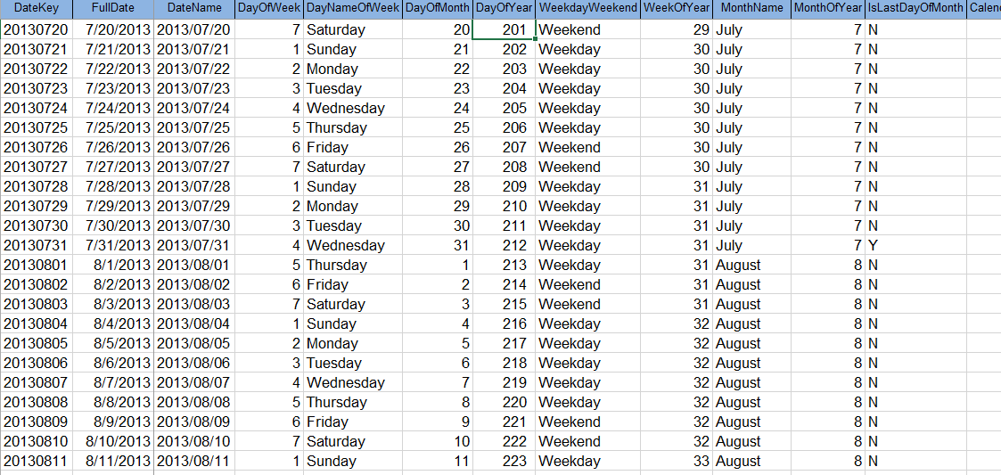
Ex. Date Dimension
Demonstrate Date and Time dimensions on SQL Server

Slide 27
How do you handle Time Zones?
Express time in coordinated universal time (UTC)
Express in local time, too.
Other options: use a single time zone (for example, ET) to express all times in this zone.
local call date
dimension
Call Center Activity Fact
Local call date key FK
UTC call date key FK
Local call time of day FK
UTC call time of day FK
…
Local call time of
day dimension
UTC call date
dimension
UTC call time of
day dimension

Slide 28
Degenerate Dimensions
Dimensions we store in the fact table, because there’s too many of them for their own a dimension. (For example a 1-1 relationship from fact to dimension)
These occur in transaction fact tables that have a parent child (One to Many) structure.
Ex. Order → Order Detail,
Airline Ticket → Flights
Allow us to drill-through to operational data, in the ODS.
Usually ends up as part of the primary key of the fact table.

Slide 29
Slowly Changing Dimensions
Dimensional data changes infrequently but when it does you need a strategy for addressing the change.
Ex: What happens when a customer has a new address, or an Employee has a name change?
4 Popular strategies
Type 1: Overwrite the existing attribute
Type 2: Add a new Dimension row
Type 3: Add a new Dimension attribute -
Mini-Dimension: Add a new Dimension
These strategies are not mutually exclusive, and can be combined.

Slide 30
Type 1: Overwrite
Appropriate for:
correcting mistakes or errors in data
changes where historical associations do not matter
the old value has no significance
If the previous value matters, don’t use this strategy. You are rewriting history.
Problems will occur with data aggregated on old values.
Ex. Employee Name Changes, Corrections, Natural Key Edits.

Slide 31
Type 2: Add New Dimension Row
Most popular strategy, as it preserves history
Natural key is repeated.
Old and new values are stored along with effective dates and indicator of which row is “current”
Product Key | Product Descr. | Product Code | Department | Effective Date | Expiration Date | Current Row
11981 | Stapler, Red | ST901 | Accessories | 4/7/2010 | 9/1/2011 | N
20344 | Stapler, Red | ST901 | Supplies | 9/2/2011 | 3/31/2013 | N
45393 | Stapler, Red | ST901 | Office Supplies | 4/1/2013 | 12/31/9999 | Y
The Change

Slide 32
Type 3: Add A New Dimension Attribute
Infrequently used, preserves history
Useful for “Soft” changes where users might want to choose between the old and new attribute, or need to access both values for a time.
The new value is written to the existing column, the old value is stored in a new column.
This way queries do not have to be re-written to access the new attribute.
Ex. Redistricting sales territories. Re-charting accounting codes.

Slide 33
Mini-Dimensions: Add a new Dimension
If attributes change frequently consider placing them in their own “mini-dimensions”
Most effective when you have banded values, or ranges of discrete values.
Customer Dimension
Customer key PK
Customer ID (Nat. Key)
Customer Name
…
Fact Table
Customer Key FK
Customer Demographics Key FK
… other FKeys…
… Facts…
Customer Demographics Dimension
Customer Demographics Key PK
Customer Age Band
Customer Gender
Customer Income Band
…

Slide 34
Role-Playing Dimensions
The same physical dimension plays more than one logical dimensional role.
This is common among the date dimension
Stored in the same physical table, just aliased as a view.
Examples:
Date: Order Date, Shipping Date, Delivery Date ➔ Same Date
Address: Ship to, Bill to ➔ Same Address Dimension
Airport: Arrival, Departure ➔ Same Airport Dimension

Slide 35
Junk Dimensions
Miscellaneous Flags and text attributes which do not fit within any other dimension.
Do Not make a Dimension for each one.
Instead place them in their own “Junk” dimension
Don’t Create a Row in your Junk Dimension Until You Need It in a Fact
Invoice Indicator Id | Payment Terms | Order Mode | Ship Mode
1 | Net 10 | Web | Freight
2 | Net 10 | Web | Air
3 | Net 10 | Fax | Freight
4 | Net 10 | Fax | Air
5 | Net 10 | Phone | Freight
6 | Net 10 | Phone | Air
7 | Net 15 | Web | Freight
8 | Net 15 | Web | Air

Slide 36
Snowflake & Outrigger Dimensions
When the redundant attributes are moved to a separate table to eliminate redundancy we get a snowflaked dimension.
Pros: Data is back in 3NF, saves space
Cons: More complex for users, decreased performance.
Sometimes this is desirable when there are a significant number of attributes in the outrigger dimension. These are the exception not the rule!
Product Dimension
Product Key FK
Product Name
Product Size Key FK
Product Size Dimension
Product Size Key PK
Product Size (S,M,L)
Product Size Fee

Slide 37
Hierarchies in Dimensions
Fixed hierarchies – Simply de-normalize as attributes
Ex. Product: Department -> Type
Variable-depth hierarchies - implement with a bridge table (used to resolve M-M relationships)
Should be used only when absolutely necessary
Negatively affects usability
Decreases performance
Customer Dimension
Customer Key PK
Customer Name
….
Fact Table
Date Key FK
Customer Key FK
More Foreign Keys…
Facts ….
Customer Hierarchy Bridge
Parent Customer Key PK,FK
Subsidiary Cust. Key PK,FK
# Levels from Parent
Bottom Flag
Top Flag

Slide 38
Multi-Valued Dimensions
Almost all Fact-Dimension relationships are M-1
Sometimes there’s a M-M relationship between fact and Dimension.
The Weighing factor is between 0 and 1 and should add up to 1 for each unique group key.
Health Care Billing Fact
Billing Date Key FK
Patient Key FK
Diagnosis Group Key FK
Bill Amount
More Facts ….
Diagnosis Dimension
Diagnosis Key PK
ICD-9 Code Diagnosis Description
….
Diagnosis Group Bridge
Diagnosis Group Key PK,FK
Diagnosis Key PK,FK
Weighing Factor

Slide 39
Check yourself: What Kind of Dimension?
Conformed?
Degenerate?
Slowly Changing? & Type?
Role Playing?
Junk?
Outrigger?
M-M (Bridge)?
Customers (for orders and sales leads)
The various classrooms on a college campus?
Items on a restraint menu?
Parts required to repair an automobile as part of a service record?
The instructors who teach a college class?

Slide 40
Fact Table Cases in Detail

Slide 41
Recall 3 Types of Fact Tables grain
Events or Transactions (single event)
Workflows a.k.a. Accumulating Snapshots (Events over Time)
Points in time a.k.a Periodic Snapshots (point in time)
Transaction
Accumulating Snapshot
Periodic Snapshot

Slide 42
Facts of Different Granularity == NO
A single fact table cannot have facts with different levels of granularity
All measurements must be in the same level of details
Example:
Measurements are captured for each line order except for the shipping charge which is for the entire order
Solutions:
Allocating higher level facts to a lower granularity (split shipping charge among each item)
Create two separate fact tables (Orders fact & Line Order fact)

Slide 43
Facts: Multiple currencies / Units of Measure
Measurements are provided in a local currency
Measurements should be converted to a standardized currency or else conversion rates must be stored
Similarly, in case of multiple units of measure, conversions to all different units of measure should be provided
Ex. Items received are by the box (12 in a box =Received unit factor) Received Price = Received unit factor * unit price

Slide 44
Fact less Fact tables
Business processes that do not generate quantifiable measurements
Ex: Student attendance, College adminssions
Can be easily converted into traditional fact tables by adding an attribute Count, which is always equal to 1.
Consider adding facts for when the event did not happen
Helps to perform aggregations
Ex: Attendance % present or absent versus class size.

Slide 45
Consolidated fact tables
Fact tables populated from different sources may consolidated into single fact table
Level of granularity must be the same
Measurements are listed side-by-side
Ex. by combining forecast and actual sales amounts, a forecast/actual sales variance amount can be easily calculated and stored
Sales & Forecast Fact
Date Key FK
Customer Key FK
Region Key FK
Actual Sales $
Forecast Sales $
Sales Variance $
Sales Fact
Date Key FK
Customer Key FK
Region Key FK
Actual Sales $
Forecast Fact
Date Key FK
Customer Key FK
Region Key FK
Forecast Sales $

Slide 46
Finally: Do’s and Don'ts of DM
Do not take a “report centric” approach
Reuse your dimensional models for multiple reports
Dimensional models should not be departmentally bound.
Reuse your dimensional models for multiple departments
Create dimensional models with the finest level of granularity.
This will be the most flexible and scalable option.
Use Conformed dimensions
Helps with integration efforts
Simplifies the process of creating the next data mart.

Slide 47
IST722 Data Warehousing
Dimensional Modeling
Michael A. Fudge, Jr.

